Slide 1
The United Nations Financial Situation
Jan Beagle
Under-Secretary-General for Management
United Nations
16 October 2018

Slide 2
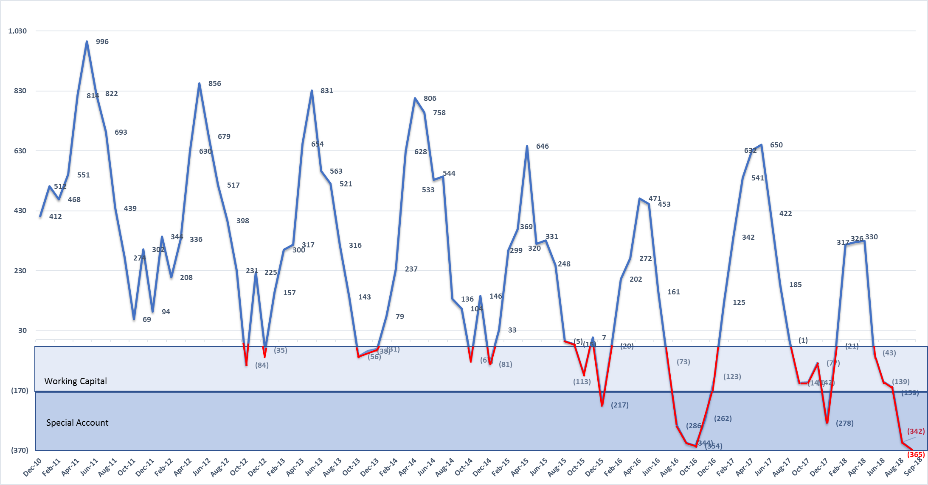
Chart 1 - Regular Budget Cash Position for 2011-2018
(US$ millions)
The United Nations Financial Situation
Regular budget
Peacekeeping
Tribunals
Cash deficit as of 30 September 2018 is $365 million.
Working Capital Fund of $150 million and Special Account of $203 million have been exhausted.

Slide 3
Chart 2 - Regular Budget: Assessment Status
(US$ millions)
The United Nations Financial Situation
 | 30 Sep 2017 | 30 Sep 2018 | Difference
Prior year’s balance (1 January) | 409 | 531 | 122
Assessments | 2,578 | 2,487 | (91)
Payments received | 1,892 | 1,930 | 38
Unpaid assessments | 1,095 | 1,088 | (7)
Regular budget
Peacekeeping
Tribunals

Slide 4
Chart 3 - Regular Budget Assessments Number of Member States paying in full at Year-end
The United Nations Financial Situation
Regular budget
*
Peacekeeping
Tribunals
* At 30 September 2018, compared to 134 Member States as at 30 September 2017
3

Slide 5
Chart 4 - Regular Budget Assessments Fully paid at 30 September 2018: 141 Member States*
Afghanistan
Albania
Algeria
Andorra
Antigua and Barbuda
Armenia
Australia
Austria
Azerbaijan
Bahamas
Bahrain
Barbados
Belarus
Belgium
Benin
Bhutan
Bolivia
Bosnia and Herzegovina
Botswana
Brunei Darussalam
Bulgaria
Cabo Verde
Cambodia
Canada
Central African Republic
Chad
Chile
China
Cote d'Ivoire
Croatia
Cuba
Cyprus
Czech Republic
Denmark
Dominican Republic
Ecuador
Egypt
El Salvador
Equatorial Guinea
Eritrea
Estonia
Eswatini
Ethiopia
Fiji
Finland
France
Georgia
Germany
Greece
Guatemala
Guinea
Guinea-Bissau
Guyana
Honduras
Hungary
Iceland
India
Indonesia
Iraq
Ireland
Italy
Jamaica
Japan
Jordan
Kazakhstan
Kiribati
Kuwait
Kyrgyzstan
Lao People’s
Democratic Republic
Latvia
Liberia
Liechtenstein
Lithuania
Luxembourg
Malawi
Malaysia
Maldives
Mali
Malta
Marshall Islands
Mauritania
Mauritius
Mexico
Micronesia
Monaco
Mongolia
Montenegro
Morocco
Myanmar
Namibia
Nauru
Nepal
Netherlands
New Zealand
Nicaragua
Nigeria
Norway
Pakistan
Paraguay
Philippines
Poland
Portugal
Qatar
Republic of Korea
Republic of Moldova
Romania
Russian Federation
Rwanda
Saint Lucia
Saint Vincent
and the Grenadines
Samoa
San Marino
Serbia
Sierra Leone
Singapore
Slovakia
Slovenia
South Africa
South Sudan
Spain
Sri Lanka
Sudan
Sweden
Switzerland
Syrian Arab Republic
Tajikistan
Thailand
The former Yugoslav
Republic of Macedonia
Trinidad and Tobago
Tunisia
Turkey
Turkmenistan
Tuvalu
Ukraine
United Arab Emirates
United Kingdom Uzbekistan
Vanuatu
Viet Nam
Zambia
Zimbabwe
The United Nations Financial Situation
Regular budget
Peacekeeping
Tribunals
* Compared to 134 Member States at 30 September 2017

Slide 6
Chart 5 – Unpaid Regular Budget Assessments (US$ millions)
The United Nations Financial Situation
Member State |  | 30 Sep 2017 | 30 Sep 2018
United States |  | 865 | 842
Brazil |  | 66 | 93
Argentina |  | 26 | 39
Iran (Islamic Republic of) |  | 19 | 30*
Saudi Arabia |  | 0.2 | 27**
Other Member States |  | 119 | 57
Total |  | 1,095 | 1,088
Regular budget
Peacekeeping
Tribunals
* Payment of $5 million received subsequent to 30 September 2018.
** Full payment received subsequent to 30 September 2018.
5

Slide 7
Chart 6 - Unpaid Regular Budget Assessments as at 30 September 2018
(52 Member States, 1,087,671,794)
The United Nations Financial Situation
Regular budget
Peacekeeping
Tribunals
* By resolution 73/4, the General Assembly agreed that the failure to pay the full minimum amount necessary to avoid the application of Article 19 of the Charter was due to conditions beyond control.
** Full payment received subsequent to 30 September 2018.
*** Partial payment received subsequent to 30 September 2018.
6

Slide 8
Chart 7 – Peacekeeping: Assessment Status at 30 September 2018 (US$ millions)
The United Nations Financial Situation
Outstanding assessments at 31 Dec 2017 | 1,930
Assessments during Jan – Sep 2018 | 4,856
Total | 6,786
Payments/credits received during Jan – Sep 2018 | 4,263
Outstanding assessments at 30 Sep 2018 | 2,523
Regular budget
Peacekeeping
Tribunals
7

Slide 9
Chart 8 - Outstanding Payments to Member States
(US$ millions)
 | 31 Dec 2016 | 31 Dec 2017 | 30 Sep 2018ª
Troops/formed police units | 249 | 250 | 92
COE claims (active missions)^{b} | 475 | 460 | 43
COE claims (closed missions) | 86 | 86 | 86
TOTAL^{c} | 810 | 796 | 221
The United Nations Financial Situation
Regular budget
Peacekeeping
Tribunals
ª Payments for troops/formed police unit costs are current for all missions up to July 2018 except MINUJUSTH, MINURSO, UNFICYP, and UNISFA. Payments for COE for active missions are current up to June 2018 except for MINUJUSTH, MINURSO, UNFICYP and UNAMID.
^{b} Claims awaiting MOU signature (estimated at $238 million), and current claims that are being certified ($235 million) will become payable in the December quarterly cycle.
^{c} Does not include Letters of Assist ($164 million) and death and disability claims ($8 million).
8

Slide 10
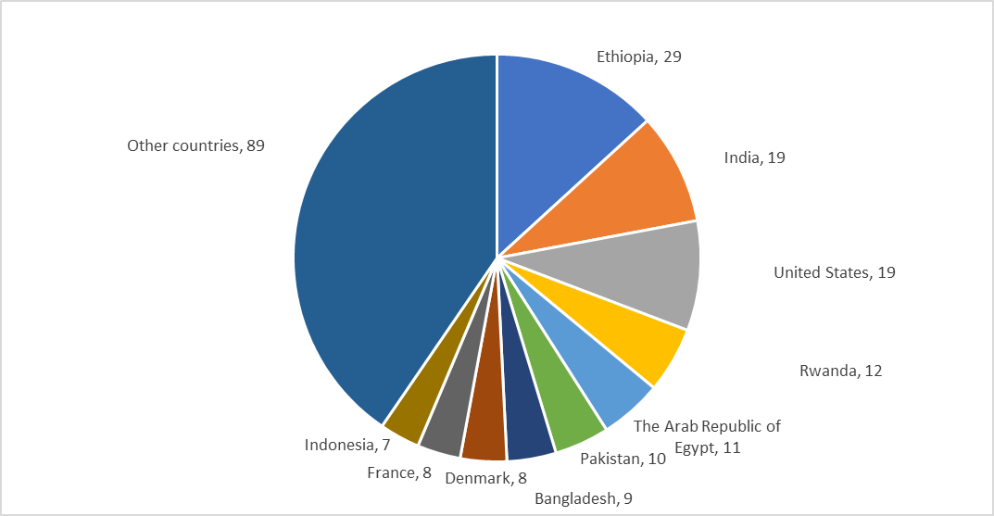
Chart 9 - Outstanding Payments to Member States
Amounts Owed for Troops/Formed Police Units and Contingent-Owned Equipment
at 30 September 2018 (US$ millions)
76 Member States
The United Nations Financial Situation
Regular budget
Peacekeeping
Tribunals
Capital Master Plan
TOTAL $221 million
9

Slide 11
Chart 10 – Unpaid Peacekeeping Assessments (US$ millions)
Regular budget
Member State | 30 Sep 2017 | 30 Sep 2018
United States | 672 | 1,216*
Brazil | 228 | 268
France | 304 | 183**
Italy | 72 | 115***
Ukraine | 113 | 103
Other Member States | 1,125 | 638
Total | 2,514 | 2,523
Peacekeeping
Tribunals
Capital Master Plan
*Payment of $172.5 million received subsequent to 30 September 2018.
**Payment of $93.6 million received subsequent to 30 September 2018.
***Payment of $106.8 million received subsequent to 30 September 2018.
10

Slide 12
Chart 11 - Unpaid Peacekeeping Assessments by Operation
as at 30 September 2018 (US$ millions)
The United Nations Financial Situation
Regular budget
Peacekeeping
Tribunals
11

Slide 13
Chart 12 - Peacekeeping Assessments Fully paid - due and payable at 30 September 2018: 41 Member States*
The United Nations Financial Situation
Algeria
Armenia
Australia
Bahrain
Belgium
Bhutan
Brunei Darussalam
Bulgaria
Canada
China
Costa Rica
Croatia
Cyprus
Czech Republic
Estonia
Ethiopia
Finland
Georgia
Germany
Hungary
Iceland
Ireland
Israel
Japan
Kyrgyzstan
Latvia
Liechtenstein
Luxembourg
Monaco
Netherlands
New Zealand
Norway
Poland
Qatar
Russian Federation
Samoa
Singapore
Slovenia
Sweden
Switzerland
Thailand
Regular budget
Peacekeeping
Tribunals
*Compared to 32 Member States at 30 September 2017
12

Slide 14
Chart 13 - Peacekeeping Cash Position
Actual Figures for Peacekeeping for 2016-2018
(US$ millions)
The United Nations Financial Situation
Regular budget
Peacekeeping
Tribunals
13

Slide 15
Chart 14 - Tribunals: Assessment Status*
The United Nations Financial Situation
The United Nations Financial Situation
 | 30 September 2017 | 30 September 2018
Member States paid in full | 106 | 58
Member States with amounts outstanding to one or both tribunals, and/or international residual mechanism | 87 | 135
Payments received (US$ millions) | 100 | 72
Unpaid Assessments (US$ millions) | 49 | 68
Regular budget
Regular budget
Peacekeeping
Peacekeeping
Tribunals
Tribunals
* Including assessments for the International Tribunal for the Former Yugoslavia, the International
Criminal Tribunal for Rwanda, and the International Residual Mechanism for Criminal Tribunals.
14

Slide 16
Chart 15 - Tribunals Assessments as at 30 September 2018
The United Nations Financial Situation
Regular budget
Peacekeeping
Tribunals
15

Slide 17
Chart 16 - Unpaid Tribunal Assessments
(US$ millions)
The United Nations Financial Situation
Member State | 30 Sep 2017 |  | 30 Sep 2018
United States | 18 |  | 33
Russian Federation | 13 |  | 17
Indonesia | 5 |  | 5
Brazil | 4 |  | 3
Saudi Arabia | 1 |  | 2
Other Member States | 8 |  | 8
Total | 49 | 68
Regular budget
Peacekeeping
Tribunals
16

Slide 18
Chart 17 - Tribunal Assessments Fully paid at 30 September 2018: 58 Member States
Algeria
Armenia
Australia
Austria
Bahrain
Barbados
Bhutan
Bosnia and Herzegovina
Brunei Darussalam
Canada
China
Costa Rica
Cyprus
Czech Republic
Denmark
Ethiopia
Finland
France
Georgia
Germany
Guyana
Haiti
Hungary
Iceland
Ireland
Israel
Japan
Kuwait
Kyrgyzstan
Latvia
Liechtenstein
Luxembourg
Malawi
Micronesia
Monaco
Mongolia
Montenegro
Netherlands
New Zealand
Norway
Pakistan
Poland
Qatar
Republic of Moldova
Saint Vincent
and Grenadines
Samoa
Serbia
Singapore
Slovenia
Solomon Islands
Sweden
Switzerland
Syrian Arab Republic
Thailand
Turkey
Ukraine
United Kingdom
Zambia
The United Nations Financial Situation
Regular budget
Peacekeeping
Tribunals
17
*Compared to 106 Member States at 30 September 2017

Slide 19
Chart 18 - Outstanding Tribunal Assessments at 31 December (US$ millions)
The United Nations Financial Situation
*
Regular budget
Peacekeeping
Tribunals
* Outstanding as at 30 September 2018
18

Slide 20
Chart 19 - Tribunals Cash Position Actual Figures for Tribunals for 2016-2018 (US$ millions)
The United Nations Financial Situation
Regular budget
Peacekeeping
Tribunals
19

Slide 21
Chart 20 - All Assessments Paid in Full as at 16 October 2018: 43 Member States*
Algeria
Armenia
Australia
Azerbaijan
Bahrain
Bhutan
Brunei Darussalam
Bulgaria
Canada
China
Cuba
Cyprus
Czech Republic
Democratic Republic of the Congo
Estonia
Ethiopia
Finland
Georgia
Germany
Hungary
Iceland
India
Ireland
Japan
Kuwait
Kyrgyzstan
Latvia
Liechtenstein
Luxembourg
Monaco
Netherlands
New Zealand
Norway
Poland
Qatar
Saint Vincent and the Grenadines
Samoa
Singapore
Slovenia
Sweden
Switzerland
Thailand
Tuvalu
The United Nations Financial Situation
20
*Compared to 31 Member States at 6 October 2017

